Slide 1



Introducing Power Features in PowerPoint
June 2020
Lucas Jellema, CTO & Architect AMIS | Conclusion

Slide 2

Building a cloud based IoT Platform to power the energy transition in The Netherlands
Digital Xchange – 6th June 2020
Lucas Jellema, CTO & Architect AMIS | Conclusion
Notes:
This is the story of a Dutch utilities company that is building an IoT Platform to collect real time metrics on energy consumption from hundreds of thousands of households in order to operate the heat grid with greater efficiency, predict demand and ultimately actively operate actuators in the field. This session explains the challenges in this process - from the embedded firmware, LTE-M communication, security and the automated provisioning to the cloud based platform for processing millions of data points, monitoring vast numbers of devices and publishing analytics to enterprise applications. Several architecture concepts are applied - decoupling and encapsulation, serverless and message driven. The platform is built on largely managed cloud services on Azure Cloud. An overview of the cloud solution is presented. We believe this platform will make a contribution against climate change.

Slide 3
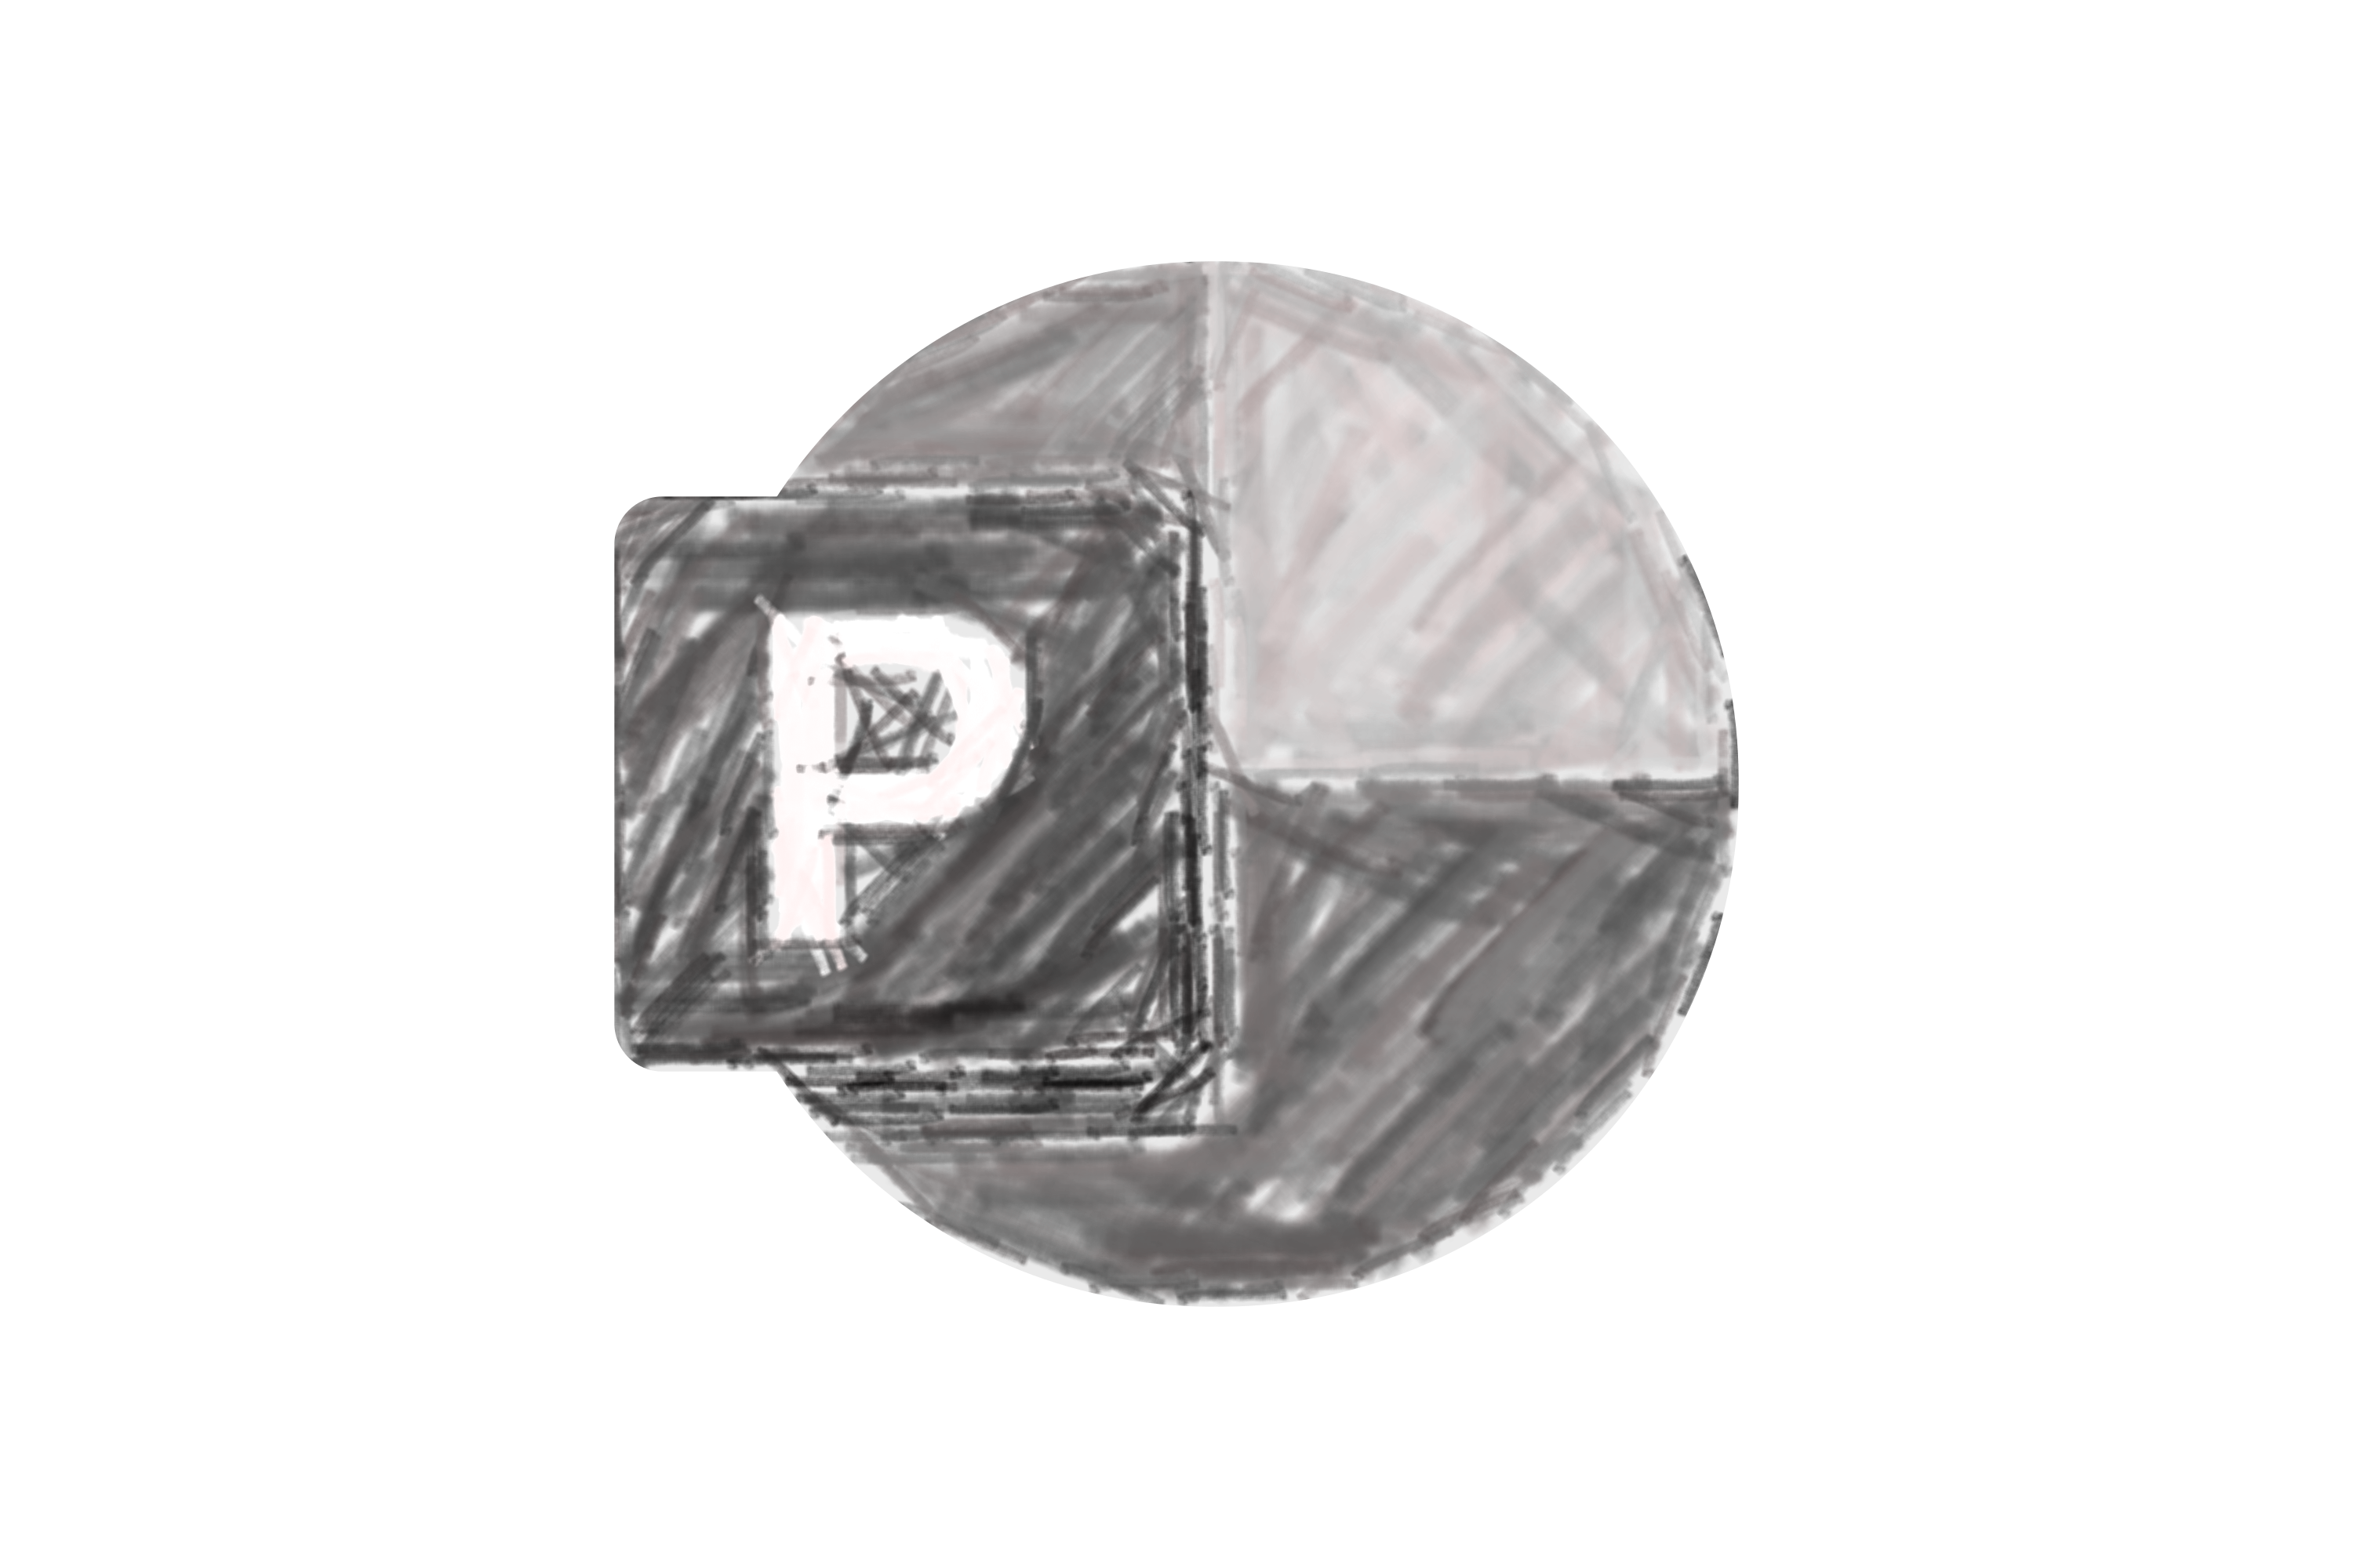
Overview
Morph
Video
Zoom
Inking & Sketchy Mode
Icons & SVG
3D Models
Design Ideas
Design Time
Merge Shapes
Record
Export
Remove Image Background (“green screening”)
Reuse Slides

Slide 4
Overview
Morph
Video
Zoom
Inking
Icons & SVG
3D Models
Design Ideas

Slide 5
Overview
Morph
Video
Zoom
Inking
Icons & SVG
3D Models
Design Ideas

Slide 6








Slide 7
Notes:
https://www.havain.fi/morph-in-powerpoint-the-ultimate-game-changer-for-your-presentation-part-2/

Slide 8
Bending it…

Slide 9
Bending it…
Notes:
Demonstrating Morph – the transition to this slide will bend the straight line to the curved one
Note: open Selection Pane. Line and Arc habe the same name !!line

Slide 14
Put
These
The
In
Order
Correct
Words

Slide 15
Put
These
Words
In
The
Correct
Order

Slide 16


Slide 17
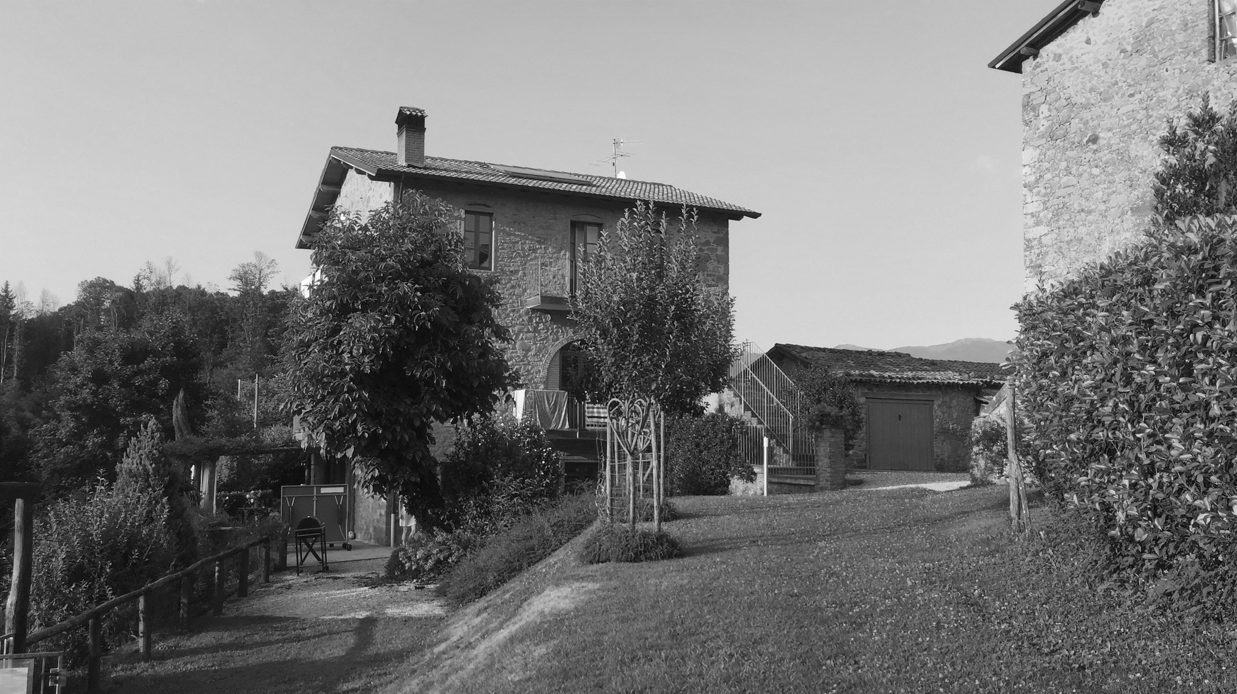

Slide 18
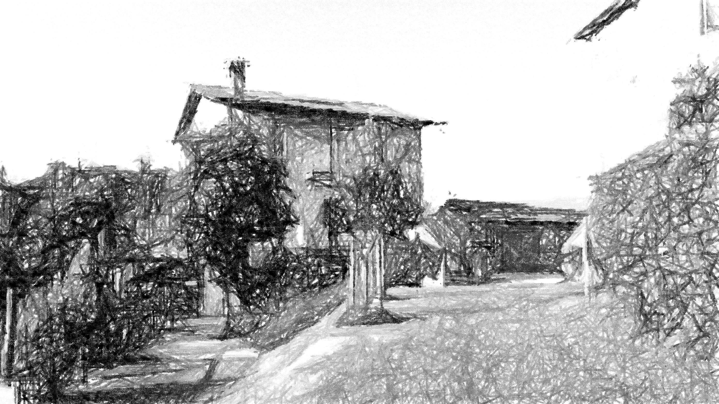

Slide 19


Slide 22
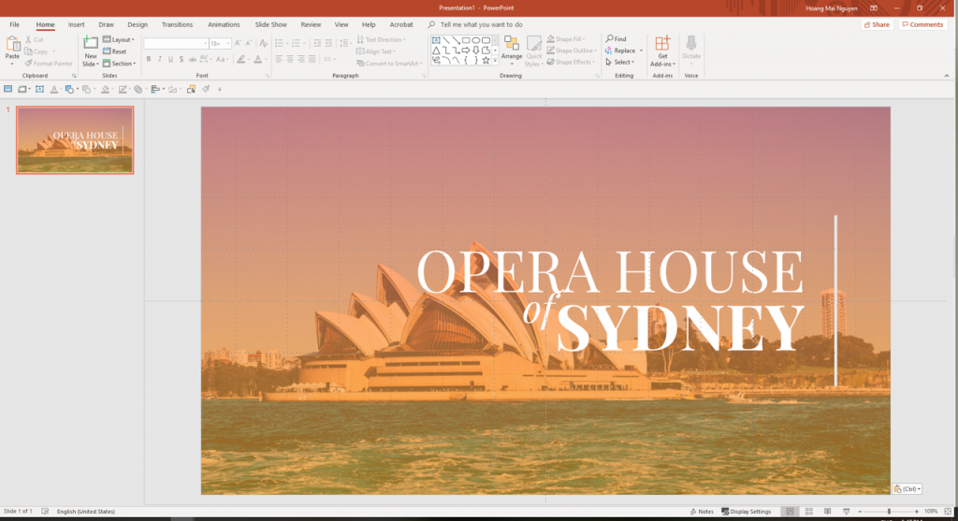

Slide 23


Slide 24
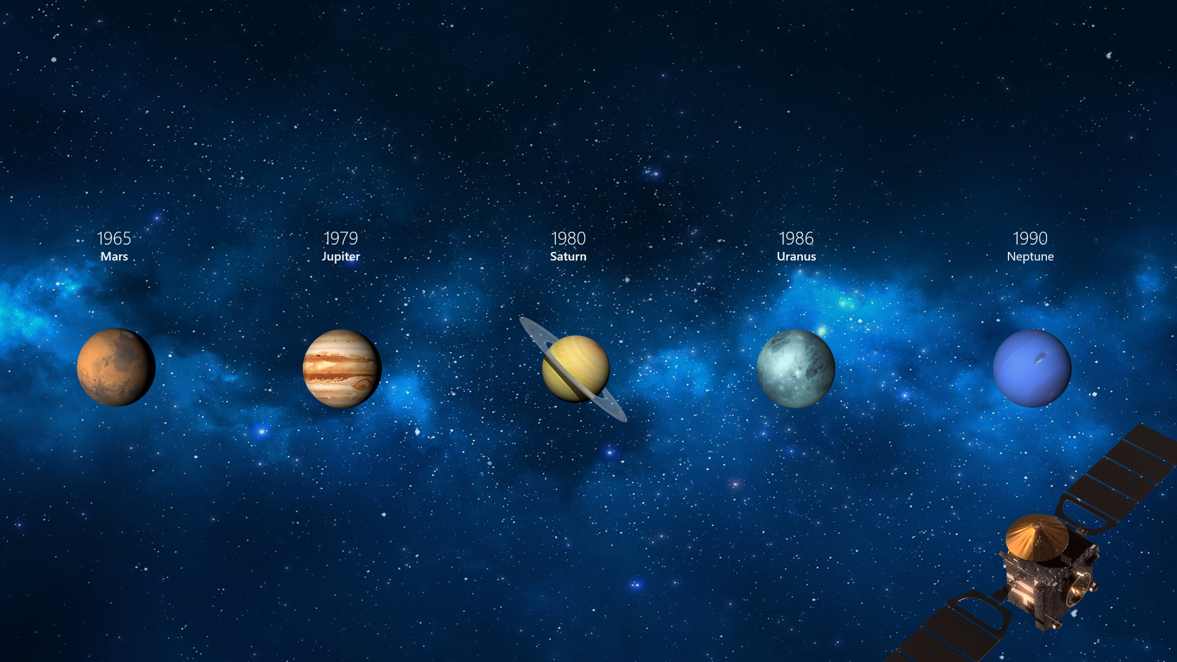
Morph Demo
Notes:
https://support.office.com/en-us/article/use-the-morph-transition-in-powerpoint-8dd1c7b2-b935-44f5-a74c-741d8d9244ea

Slide 25
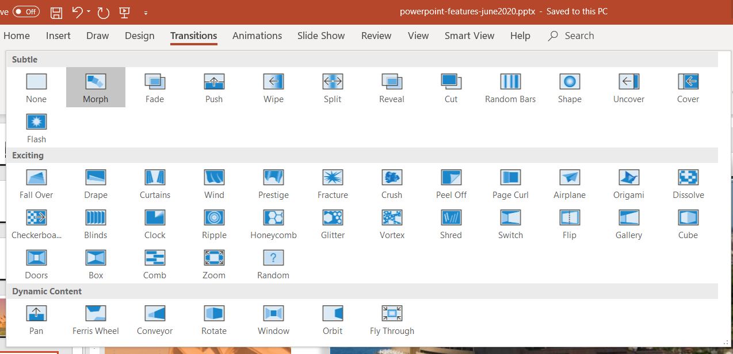
Morph is special type of slide transition

Slide 26

Many more slide transition styles are available

Slide 27

Many more slide transition styles are available

Slide 28

Many more slide transition styles are available

Slide 33

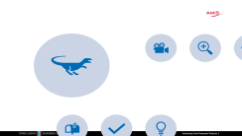
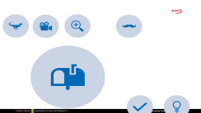
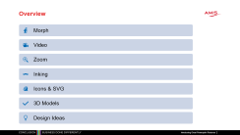
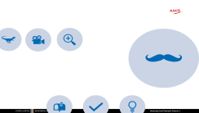
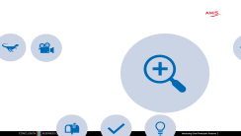


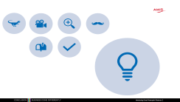
Zoom – Summary Slide

Slide 34
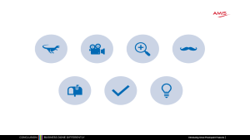
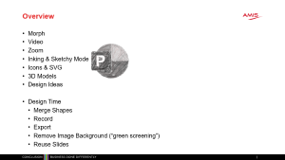
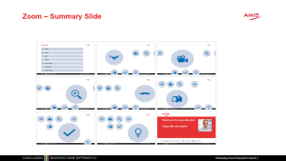

Zoom – Slide Links

Slide 39


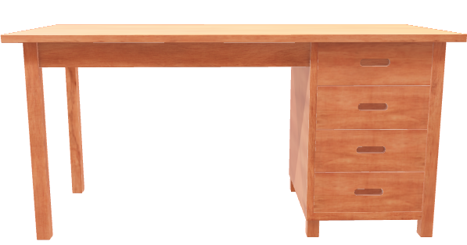

Slide 40


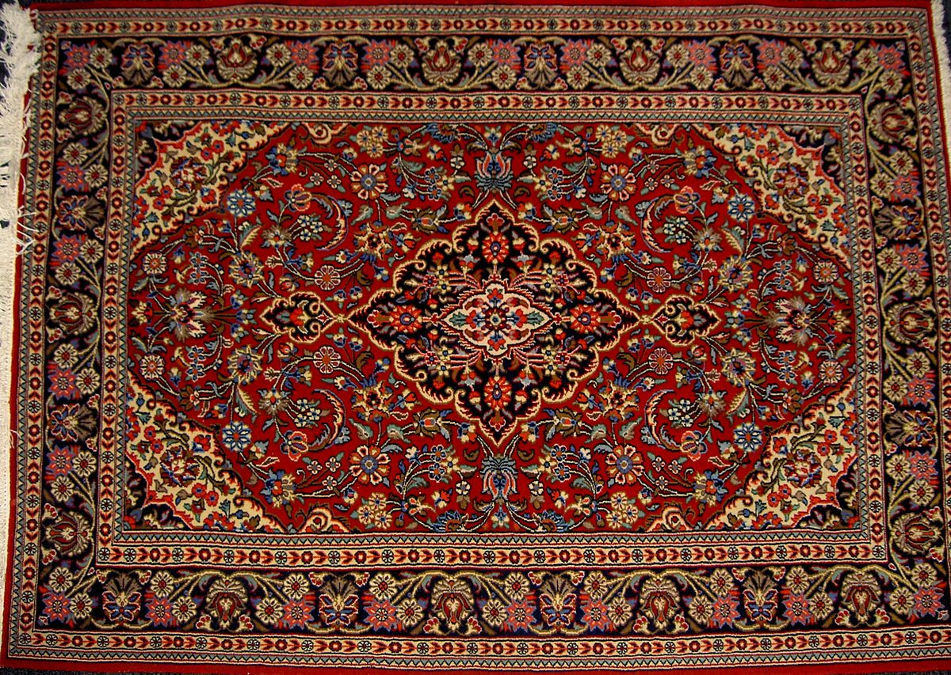




This Photo by Unknown Author is licensed under CC BY-SA

Slide 41



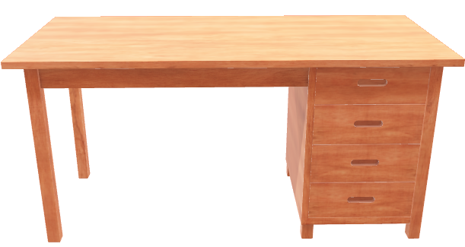
This Photo by Unknown Author is licensed under CC BY-SA

Slide 46
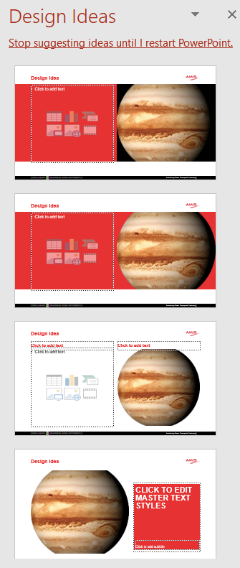
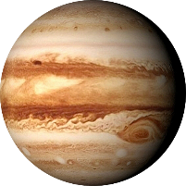
Design Idea

Slide 47
Design Idea
Jupiter
Largest planet of our Solar System

Slide 48
Design Idea
Jupiter
Largest planet of our Solar System

Slide 51


Thank you for your attention I hope this was useful
lucas.jellema@amis.nl | technology.amis.nl | @lucasjellema | lucas-jellema

